Slide 1
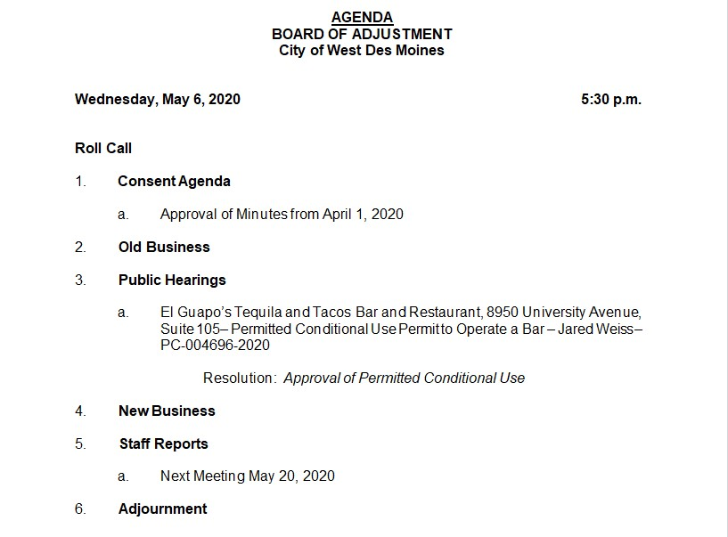

Slide 2
Welcome to the May 6, 2020 West Des Moines Plan Board of Adjustment Meeting
Here are a few housekeeping items before we get started:
Any applicants, consultants and most staff joining the meeting are muted by default. Please wait until the Commission Chair asks for the applicant's or staff's presentation on an item, then you may raise your hand to speak. The Chair will then call on you and you will be unmuted.
When the meeting is in session, please write in the chat box (which is the speech bubble icon in the bottom bar) and let us know if you can’t see or hear something or you are having other issues
Raise Hand:
Location - Click participants in your bottom Zoom toolbar, you will see this at the bottom of the participants box:
Chat:
Location - Click on the speech bubble in your bottom Zoom toolbar
If you have the meeting display on Full Screen, some or all of the Participants box may be hidden. In the top right corner of the display, there is a button that will say “Exit Full Screen”. Choose that and the meeting display will shrink and you can move it to the side so you have room to show the Participant box and the Chat box off to the side of the main display.

Slide 3
