Slide 1

The Economic & Social Impact of
Nonprofit Arts & Culture Industry
Greater Des Moines Region!
(Dallas, Polk, Warren Counties)
November 16, 2023
Randy Cohen
Americans for the Arts
@ArtsInfoGuy
Notes:
Arts and culture builds stronger communities. Every day nonprofit arts and culture organizations are making their communities better places to live and work by beautifying cities, fueling creativity, celebrating diversity, and bringing joy to residents. They also employ people locally, purchase goods and services from nearby businesses, and produce the authentic cultural experiences that are magnets for visitors, tourists, and new residents.
AEP6 changes the conversation about the arts from that of a “charity” to one about an “investment in an industry” that provides both social, economic, and cultural benefits to the community.
“How can a group of arts organizations stimulate the economy?” (Tell a personal arts spending story that demonstrates how many industries benefit from arts spending.)

Slide 2
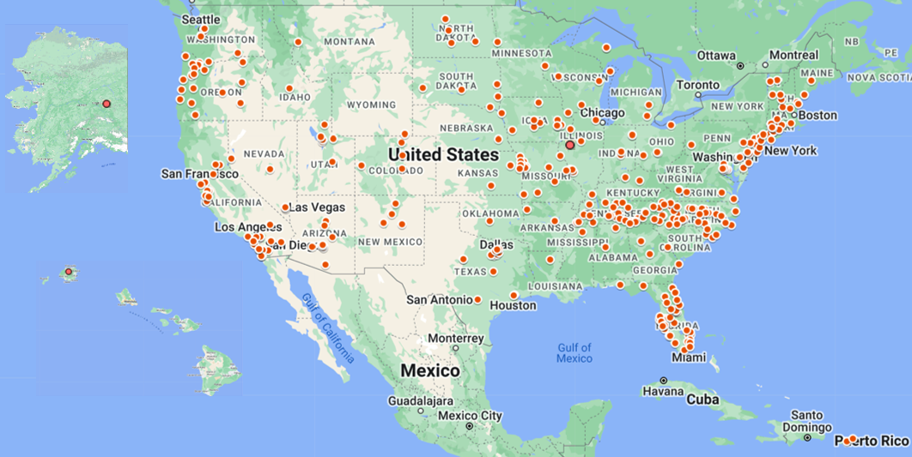
Most Comprehensive Study Ever!
373 Study Regions in all 50 States and Puerto Rico.
Notes:
AEP6 is the 6th economic and social impact study of spending by nonprofit arts and cultural organizations and their audiences. It is the largest and most comprehensive of its kind ever conducted: 373 study regions in all 50 states + Puerto Rico, including small rural to large urban communities and populations ranging from 4,000 to 4 million. Even in our smallest communities, the arts have a measurable economic impact.
Only nonprofit and municipal arts and cultural organizations are included—no for-profit entertainment businesses such as Broadway or the motion picture industry, and no individual artists (all vital to the cultural ecology, but beyond the scope of the study).
Why just nonprofits? Because government and philanthropic dollars are typically directed to these organizations. It is appropriate to ask, “Beyond quality of life, what is the ROI of that investment?”
Conservative and Reliable Methodology . . .
We only include data from organizations that provide it. We make no local estimates for non-respondents. (##### organizations surveyed.)
We do a major over-sample of audience interviews and conduct them at a diverse range of events (performing arts, museums, free open air festivals). (##### surveyed.)
We customize input/output models using the IMPLAN platform to provide reliable local data. It measures how a dollar is respent in the local economy, and what the economic impact of each round of spending is. For example, when a theater company purchases paint from the local hardware store, that has a measurable economic effect. However, the economic benefits typically don’t end there, because the hardware store uses some of its income to pay the clerk that sold the paint as well as to pay its utility bill and other expenses. The clerk may use some of those dollars to pay the grocery bill, and so on. Each round of spending and its impact is measured. (Input/output models have been the basis of multiple Nobel Prizes in Economics. The AEP methodology has been vetted by the White House Council of Economic Advisors and bank economists among others.)

Slide 3

$309.9 Million in Spending (2022)
Greater Des Moines Region
@ArtsInfoGuy
Notes:
Total economic activity. Composed of two figures—spending by nonprofit arts and cultural organizations and the event-related spending by their audiences.
Nonprofit arts and cultural organizations spent an estimated $##### in 2022. This is a myth buster. We appreciate the beauty of the arts, but most people don’t realize that arts organizations are also businesses. They employ people locally, purchase goods and services within the community, are members of the Chamber of Commerce, and involved in the marketing and promotion of their regions. Arts organizations are good business citizens.
Unlike most industries, the arts generate significant amounts of event related spending (meals, lodging, retail shopping, transportation, babysitting). This generates significant revenue to local merchants.
What is the economic impact of that spending?

Slide 4
Jobs Supported
5,439
@ArtsInfoGuy
Notes:
Arts organizations employ more than just artists, curators, and musicians. They also pay builders, plumbers, accountants, printers, and occupations spanning many industries. These jobs are also the result of audience spending, not just organizational spending.
Remember that our economic analysis measures jobs supported throughout the community, not just AT arts organizations.
Because arts organizations are strongly rooted in their community, these are jobs that necessarily remain local and cannot be shipped overseas. (Even in a global economy, arts remain local employers)

Slide 5
Personal Income to Residents
$208.7 Million
@ArtsInfoGuy
Notes:
Personal income is the money earned and received by individual in the study region as a result of the economic activity by organizations and audiences. It is what we earn to make a living and then use to pay our bills, rent, utilities, etc.

Slide 6
Government Revenue
(Local, State, Federal)
$66.9 Million
@ArtsInfoGuy
Notes:
These are the taxes and collections made by local, state, and federal governments in 2022 as a result of the economic activity of nonprofit arts and culture organizations and their audiences.
This study corrects the mistaken assumption that the arts and culture industry only takes, but does not give back. Arts funding to nonprofits is not a one-way street. It gives back to the community (jobs, household income, and government revenue).

Slide 7
Attendees Spent
$39.66 Per Person, Per Event
@ArtsInfoGuy
Notes:
LIKE all industries, spending by arts organizations has a measurable economic impact. UNLIKE most industries, the arts generate a bounty of event-related spending for local businesses—dollars that land in the pockets of local business establishments such as parking garages, restaurants, retail stores, hotels, and even the local babysitters.
We did [####--in your report] audience surveys. This is what the average spending looks like.
Some number such as Lodging and Child Care look low. Remember, these are averages and not everyone has these costs. Nationally, only 5% of survey respondents had a lodging cost for example.
Nationally, in the chart above, the typical attendee spent $38.46 per person, per event not including admission or onsite food and beverage costs. (This amount is up from $31.47 in 2017*

Slide 8
Audiences: Local vs. Non-Local
(Nonlocal = Outside the 3-County Region)
@ArtsInfoGuy
Notes:
In addition to spending information, interviewed attendees also provided their zip code so we could determine whether they live IN the county in which the arts event takes place (local) or outside the county (non-local).
Nationally, in the chart above, 30 percent of arts attendees come from outside of the county that they live in (down from 34% in 2017).
Does their spending differ from local attendees . . .?

Slide 9
Event-Related Spending
Local vs. Non-Local
67% of nonlocal attendees said, “This arts event is the primary purpose for my trip.”
@ArtsInfoGuy
Notes:
79% of Americans agree, “The arts attract travelers and are good for tourism.”
70% agree, “The arts improve the image and identity of my community.”
53% say, “When planning a vacation, I consider the destination’s arts and culture
experiences when deciding where to visit.”
With this level of public understanding of the arts and tourism connection, it is no surprise that 66% favor government funding the arts as a means to increase tourism.
Nationally, nonlocal attendees spend $60.57 per person, per event, not including admission—more than twice as much as their local counterparts.
We asked non-local attendees, “Why are you here?” [XX … IN YOUR REPORT]% said, “This arts event is the primary purpose for my trip.”
We asked local attendees about what they would have done if the arts event that they were attending was not taking place: [XX … IN YOUR REPORT] said they would have “traveled to a different community to attend a similar arts event.”
Of the XX% of arts attendees who are nonresidents, XX% reported an overnight lodging expense. They average $XXX per person. When you can get those “heads in beds,” that is when the cash registers start to ring. [ALL FIGURES IN YOUR REPORT]
These data show the power of the arts draw visitors into their community, and these people spend money. It also shows that the arts keep locals and their discretionary spending in the community. That is why we say a vibrant arts community is good for local businesses.
(For this analysis, only one night of lodging expenses is counted toward the audience expenditure, regardless of how many nights these cultural tourists actually stayed in the community. This conservative approach ensures that the audience-spending figures are not inflated by non-arts-related spending.)

Slide 10
Social Impact Responses by Attendees
 | Attendees at All Events (N=980) | Attendees at BIPOC Events (N=255)
“This venue or facility is an important pillar for me within my community.” | 82.9% | 87.4%
“I would feel a great sense of loss if this activity or venue were no longer available” | 86.6% | 88.5%
“This activity or venue is inspiring a sense of pride in this neighborhood or community” | 89.3% | 91.2%
“My attendance is my way of ensuring that this activity or venue is preserved for future generations” | 87.3% | 89.6%

Slide 11
Attendee Spending at
BIPOC Org’s and All Org’s
@ArtsInfoGuy
Notes:
79% of Americans agree, “The arts attract travelers and are good for tourism.”
70% agree, “The arts improve the image and identity of my community.”
53% say, “When planning a vacation, I consider the destination’s arts and culture
experiences when deciding where to visit.”
With this level of public understanding of the arts and tourism connection, it is no surprise that 66% favor government funding the arts as a means to increase tourism.
Nationally, nonlocal attendees spend $60.57 per person, per event, not including admission—more than twice as much as their local counterparts.
We asked non-local attendees, “Why are you here?” [XX … IN YOUR REPORT]% said, “This arts event is the primary purpose for my trip.”
We asked local attendees about what they would have done if the arts event that they were attending was not taking place: [XX … IN YOUR REPORT] said they would have “traveled to a different community to attend a similar arts event.”
Of the XX% of arts attendees who are nonresidents, XX% reported an overnight lodging expense. They average $XXX per person. When you can get those “heads in beds,” that is when the cash registers start to ring. [ALL FIGURES IN YOUR REPORT]
These data show the power of the arts draw visitors into their community, and these people spend money. It also shows that the arts keep locals and their discretionary spending in the community. That is why we say a vibrant arts community is good for local businesses.
(For this analysis, only one night of lodging expenses is counted toward the audience expenditure, regardless of how many nights these cultural tourists actually stayed in the community. This conservative approach ensures that the audience-spending figures are not inflated by non-arts-related spending.)

Slide 12
Arts Volunteerism
20,353 volunteers
497,000 hours
$14 million value
(Value of 2022 volunteer hour in Iowa = $28.09)
Notes:
While arts volunteers may not have an economic impact as defined in this study, they clearly have an enormous impact by helping arts organizations function as a viable industry.

Slide 13
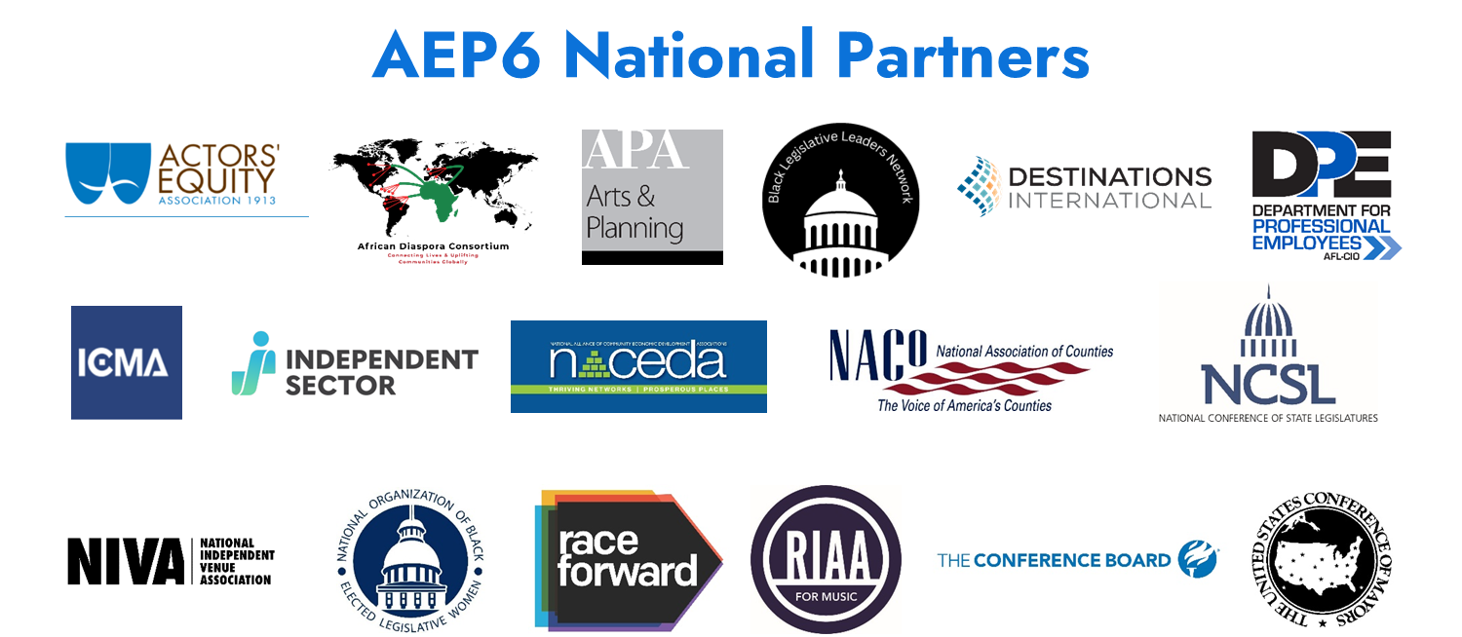
Notes:
AEP6 National Partners are organizations of public and private sector leaders that steer billions of dollars in public and private sector arts funding and create arts-friendly policies. They are partners because, (1) they too believe arts and culture are a fundamental component of a healthy community, and (2) they approve of the methodology and findings. Their names are on the back cover of every AEP6 report. This boost your credibility when advocating with the data. For example,
Be sure your mayor knows the U.S. Conference of Mayors and National League of Cites, and Black Legislative Network are partners.
Be sure your city manager know that International City/County Management Association is a partner.
Be sure your business leaders know that the Conference Board is a partner.
Be sure your private funders know that Independent Sector is a partner.
Be sure your tourism and economic development people know that Destinations International and National Alliance of community Economic Development Associations are partners.
Be sure your community organizations know that Race Forward and African Diaspora Consortium are partners.
Be sure your arts community knows that the arts unions and RIAA and NIVA are partners.

Slide 14
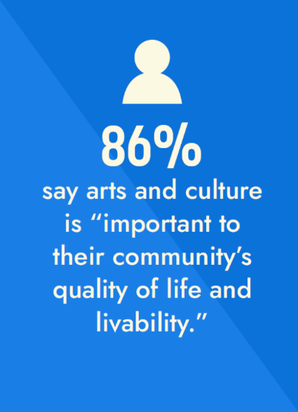
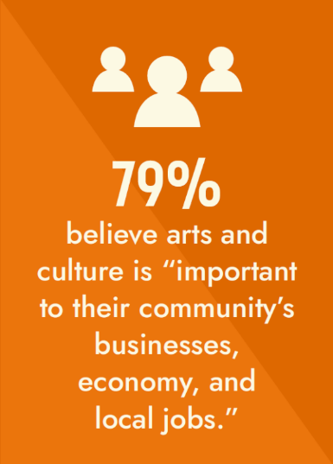
Arts & Culture is Valued by the Public
@ArtsInfoGuy
Notes:
Our community leaders are not the only ones who appreciate the quality of life AND economic value of the arts.
The American public appreciates this value that the arts bring to their community. While 86 percent believe they are important to quality of life, an impressive 79 percent also believe the arts are important to local businesses and the economy.

Slide 15
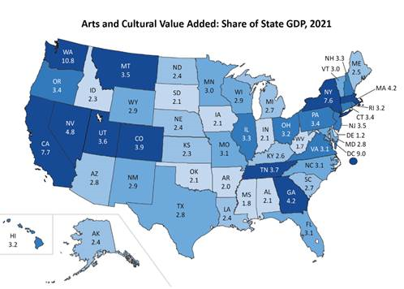
Arts & Creative Economy in Iowa
$4.5 Billion—2.1% of GSP—39,391 Jobs
Bigger than Utilities, Education, Mining!
Accelerates economic recovery
Diversifies economy
Stimulates statewide job growth
U.S.: $1.02 Trillion—4.4 Percent of GDP—4.9 Million Jobs (2021)
Source: U.S. Bureau of Economic Analysis

Slide 16
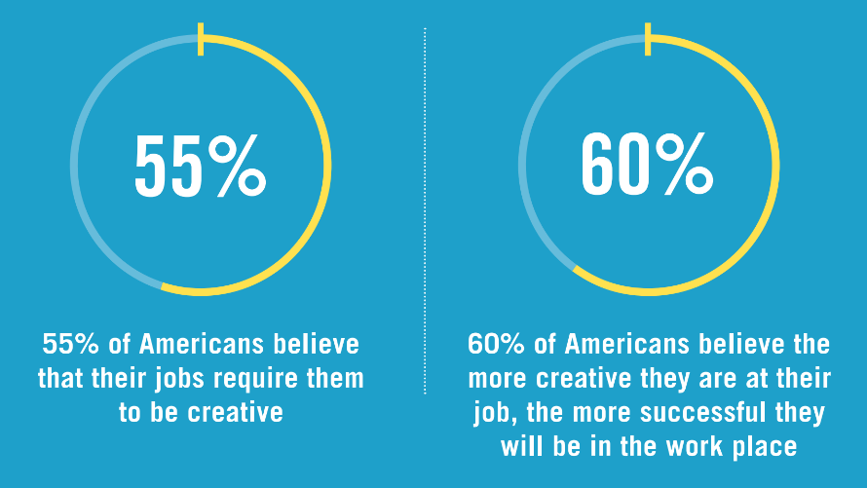
Our Jobs Require Creativity

Slide 17
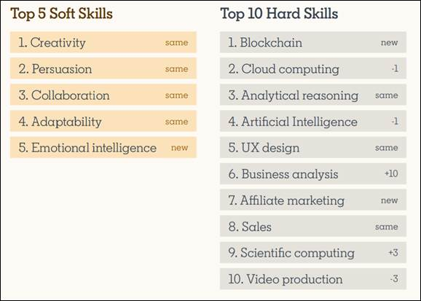

Importance of Creativity in the Workplace
“Soft skills are the essential interpersonal skills that make or break our ability to get things done. We think of them as foundational and every professional should be working to build them.”
Notes:
Some positive news from LinkedIn about the importance of creativity in the workforce. Every year they do a research study that includes ranking the most in-demand skills that companies are looking for. They provide a ranking of both “Soft Skills” and “Hard Skills.” For the second year in a row, “Creativity” tops the list of soft skills (page 35 of the report).
“Soft skills are the essential interpersonal skills that make or break our ability to get things done. We think of them as foundational and every professional should be working to build them . . . this year’s results signal that companies are gravitating more toward talent with strong people-oriented skills.”
“While the most in-demand soft skills are all about how employees work together, the most in-demand hard skills are the ones defining what they’re working on. These skills will continue to evolve as the world of work does . . . Trending data also reveals that data-driven decision making skills like analytical reasoning (#3), up one spot from last year, and business analysis (#6), up 10 spots from last year, are essential in today’s workforce.
The report is based on about 6700 survey responses from HR professionals, managers, and learners.

Slide 19
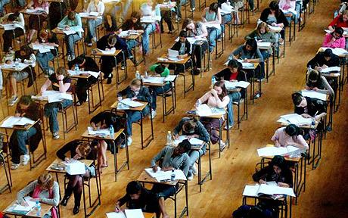
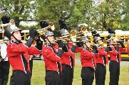
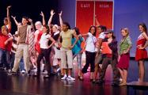

Improved Academic Performance
Notes:
CATTERALL . . .
The academic benefits of arts education go beyond math and reading. An analysis of U.S. Department of Education data by UCLA research James Catterall found that students who were highly involved in the arts performed better on a variety of academic measures than other students (grade point averages, standardized test score, lower drop-out rates, and better attitudes about community service . . . these findings also held when studied across socio-economic strata, suggesting that the arts can "level the playing field" for youngsters from disadvantaged circumstances.
Don’t take my word for it. In a recent commentary in Education Week by Arkansas Governor Mike Huckabee and former U.S. Secretary of Education Rod Paige, they write, “The arts instill in students the habits of mind that last a lifetime: critical-analysis skills, ability to deal with ambiguity and to solve problems, perseverance, and a drive for excellence.”
Now, it's hard to argue with these facts, but policy makers have found ways to ignore them. Too many of our students in our communities and classrooms simply don't have access to arts education. Last year’s report by the Council of Basic Education documented, via surveys of 1,000 school principals, what so many of us are observing. Because of No Child Left Behind laws, our schools are teaching to the test more than ever, and cutting out the liberal arts. 25 percent of the principals reported decreases in instructional time for the arts; 33 percent anticipate future decreases in instructional time.

Slide 20

Thomas Südhof
Nobel Prize for medicine:
“I owe it all to my bassoon teacher”
Drive for excellence
Visual thinking
Pattern recognition
Problem solving
Perseverance
Notes:
Total economic activity. Composed of two figures—spending by nonprofit arts and cultural organizations and the event-related spending by their audiences.
Nonprofit arts and cultural organizations spent an estimated $73.3 billion in 2023. This is a myth buster for people. Sure, we appreciate the beauty of the arts, but most folks don’t realize that these are businesses. They employ people locally, purchase goods and services within the community, are members of the Chamber of Commerce, and involved in the marketing and promotion of their regions. Arts organizations are good business citizens.
What is the economic impact of that spending?

Slide 21
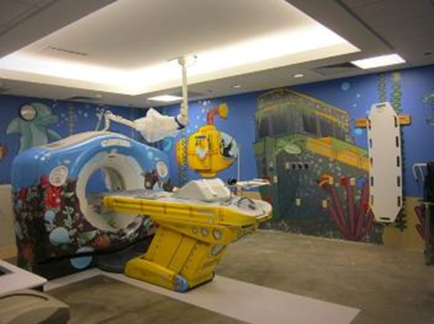
Arts Promote Physical and Emotional Healing
Shorter hospital stays
Fewer medical visits
Reduced medications
Lowers depression
Strengthens mental health
Saves money!

Slide 22
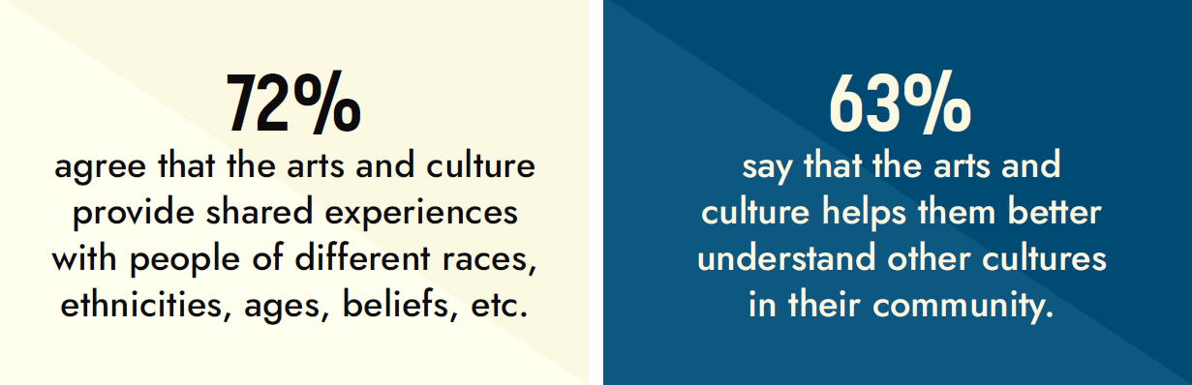
Arts Build Empathy & Understanding
@ArtsInfoGuy

Slide 23
How Can YOU Invest in Arts & Culture?
Sponsor a local event
Donate to arts and culture organizations
Volunteer at a local organization or event
Support local government funding for the arts
Attend!
@ArtsInfoGuy

Slide 24

Thank You!
AEP6.AmericansForTheArts.org
rcohen@artsusa.org
@ArtsInfoGuy
Notes:
If you are a community leader who cares about more livable communities and strengthening your economy—you can feel good about investing in arts and culture.

